Slide 1
Chain Drugstore Management System
IA1
Jashraj patel - 2021002

Slide 2
Introduction
Chain drugstore management is a business model based for the large pharmaceutical industry. Previously drug store management was done manually which was very difficult because it caused data inconsistency and data integrity problems. At present, the increasing demand for pharmaceutical products also makes the pharmaceutical industry in a period of rapid development. As the pharma industry is so immense it needs an updated business model(Chain business model) to grow and outperform their opposition. Management activity of each of these includes planning, control, and decision making. The system designed is relatively simple and practical, which is suitable for most chain drugstores. Using drugstore management immense pharma companies and pharmacies can maintain their own inventory, sales record, Drug information etc.

Slide 3
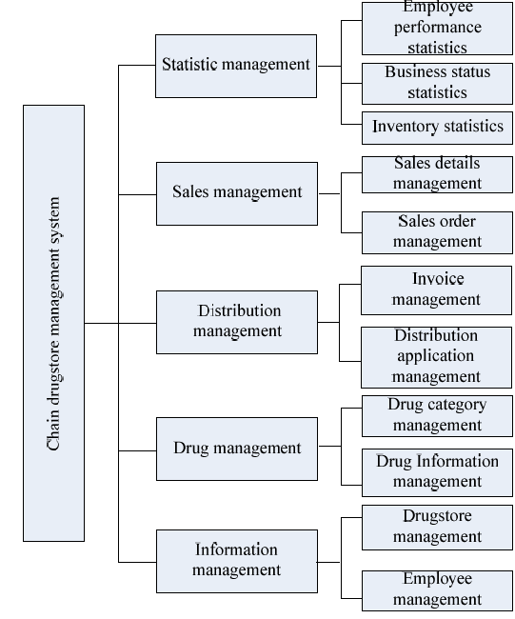
Design of management system
Information management module
Drug management module
Distribution management module
Sales management module
Statistical management module

Slide 4
Information management module
The information management module is mainly for chain drugstore management, mainly to check the basic information of related drugstores and some information of related personnel dynamics.
Example:-
Pharmacy_id
Pharmacy_Name
Contact information of the pharmacy

Slide 5
2. Drug management module
The drug management module is mainly used to manage the drug information and drug category information of the pharmacy. The sales personnel can timely check the type, name and sales unit price of each drug.
Example:-
Drug_id
Drug_Name
Drug category

Slide 6
3. Distribution management module
The distribution management module is mainly for the buyer to send a distribution application to the head office according to the demand information of various drugs and whether there is an overdue backlog of drugs, to ensure that the pharmacy's drug inventory is sufficient and there is no backlog.
Example:-
Application_no
Quantity
Price

Slide 7
4. Sales management module
The sales management module mainly records the basic information of drugs sold by salesmen, including drug number, drug name, drug unit price, sales quantity, cumulative amount, sales time and salesperson number, that is, the generation of sales order
Example:-
Sale_id
Sale_Date
Price

Slide 8
5. Statistical management module
The statistics management module mainly displays the information of commodity inventory, operation status and employee performance. It is mainly for the purpose of making statistics on some important situations of the pharmacy on a regular basis. Through these statistics, it is convenient for the manager to report the information to the superior in time, and then the superior will review it.
Example:-
Stock_id
Stock_Name

Slide 9
Database design
The database will contain the following tables:
Chain drugstores: This table will contain the information about the chain drugstores.
Drugs: This table will contain the information about the drugs
Distribution application: This form mainly stores the information of the supplied drugs.
Sold drugs: This table will store the information of drugs sold
Inventory table: This table will contain the stock of the drugs

Slide 10
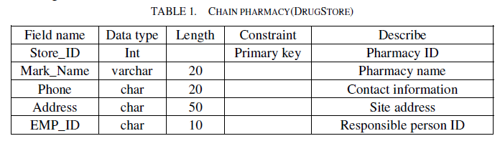
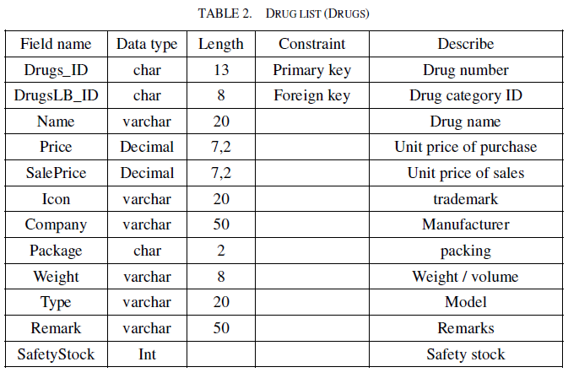
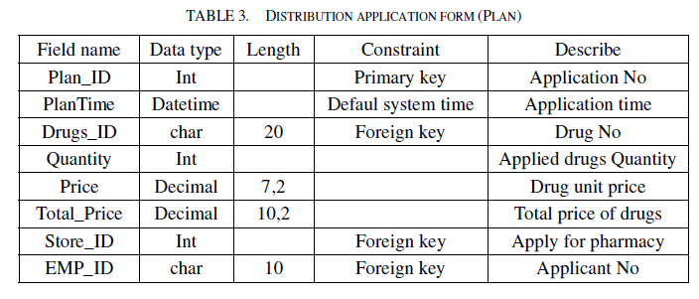
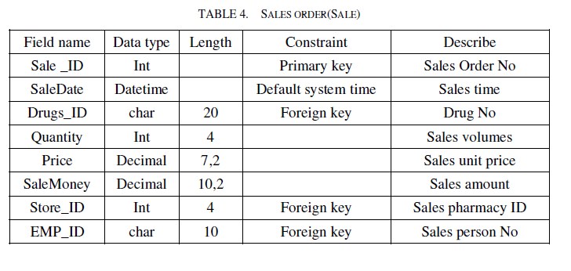
Tables in Database
Chain pharmacy
Distribution application
Drugs
Sold drugs

Slide 11
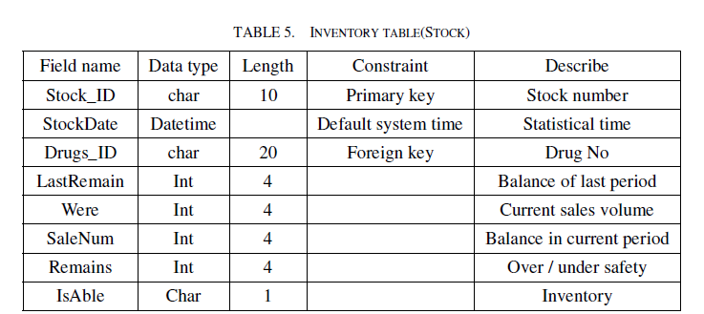
Tables in Database(Cont.)
Inventory

Slide 12
Conclusion
The main motive to design chain drugstore management was to remove the traditional manual mode and replace it by computerization. The information management, Drug management, distribution management,sales management and statistical management designed to free the chain drugstore from the pure manual management. In order to avoid low efficiency and error prone manual operation we can use chain drugstore management. It can also remove caused data inconsistency and data integrity problems.

Slide 13
Bibliography
Research paper link:- ://ieeexplore.ieee.org.library.somaiya.edu/stamp/stamp.jsp?tp=&arnumber=9148103
https://www.fieldcircle.com/importance-of-pharmacy-management-software/#:~:text=Faster%20and%20accurate%20prescription%20processing,Reduced%20paper%20work

Slide 14
Implementation strategy
EER Diagram
Relational model
All the tables will be created that are given in the research paper.

Slide 15
THANK YOU!!

